Slide 1


AI-Powered Zero-Sum Game Development
A Case Study in Tic Tac Toe
Presented by Sirak Chamiso & Adewale Francis Adewale
Supervisor: Dr. Darsana Josyula

Slide 2
Abstract
This project explores the development of a 2-player zero-sum game, implementing a game-playing algorithm to simulate intelligent competition between a human and a computer
Using heuristics, minimax, and alpha-beta pruning, the system optimizes decision-making while maintaining computational efficiency.
The project highlights the application of AI in games and its role in strategic decision-making.

Slide 3

Introduction
Overview of the Tic-Tac-Toe game implementation in Python.
Use of object-oriented programming (OOP) and artificial intelligence (AI) technique
Zero-Sum Game : A scenario where one player's gain is the exact loss of another.
Example: In Tic Tac Toe:
A win for Player 1 = a loss for Player 2.
A draw = no net advantage for either.

Slide 4

Algorithms and AI Principles
Minimax Algorithm:
A recursive algorithm used for decision-making and game theory.
Aims to minimize the possible loss for the worst-case scenario.
Alpha-Beta Pruning:
An optimization technique for the Minimax algorithm.
Reduces the number of nodes evaluated in the search tree.
Heuristic Evaluation:
A function used to evaluate the desirability of a board state.
Assigns a score based on the likelihood of winning from that state.

Slide 5
Explanation
Heuristic Function:
Evaluates the current state of the Tic-Tac-Toe board.
Winning State: Returns 1 for a favorable state to the current player.
Losing State: Returns -1 for an unfavorable state.
Draw State: Returns 0 for a neutral state.
Purpose: Enables the Minimax algorithm to select the best move out of any particular game state

Slide 6
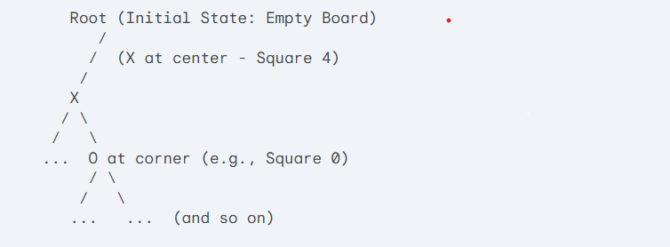
Partial Game Tree

Slide 7
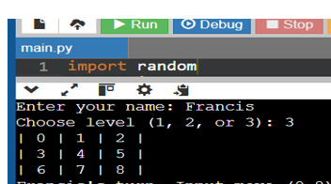
Methodology
1. Rules of the Game
Two-player Tic Tac Toe on a 3x3 grid.
Players alternate by placing X or O.
Goal: Form a straight line (row, column, diagonal) of three identical markers.
2. Initial State and Representation
Initial State: An empty 3x3 grid.
Representation: A list of 9 elements (0-8) representing board positions.
3. Valid Moves and Transitions
Markers placed in empty squares.
Game state updated after each move.

Slide 8
Three Screenshots From The Game
A. Computer wins
B. Human wins
C. No winner emerged

Slide 9
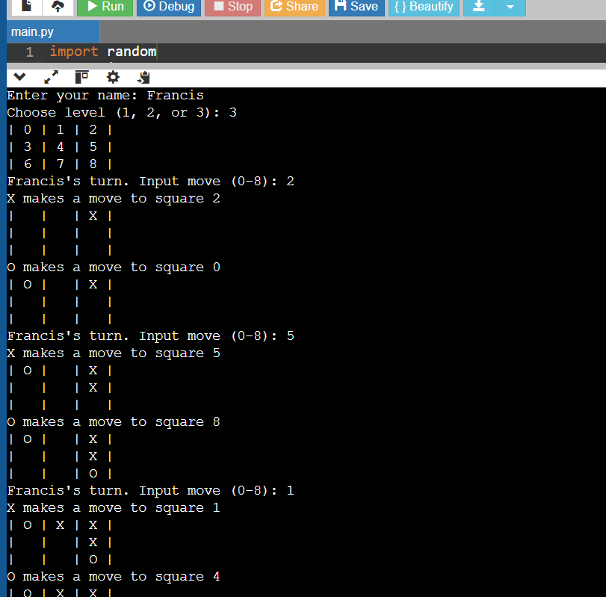
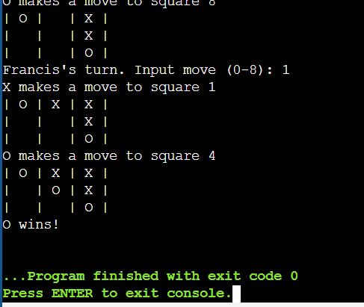
Screenshot: Computer Wins

Slide 10
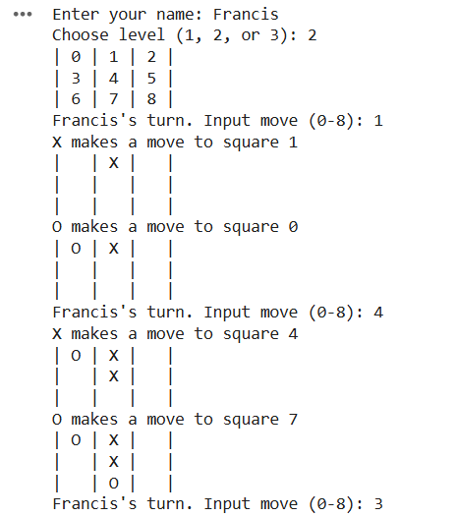
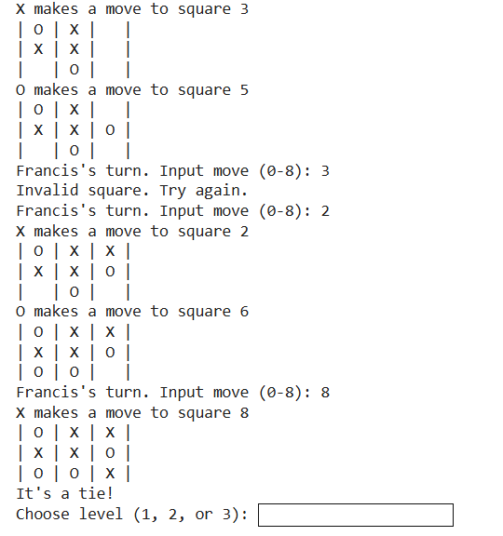
Screenshot: It’s A Tiel

Slide 11
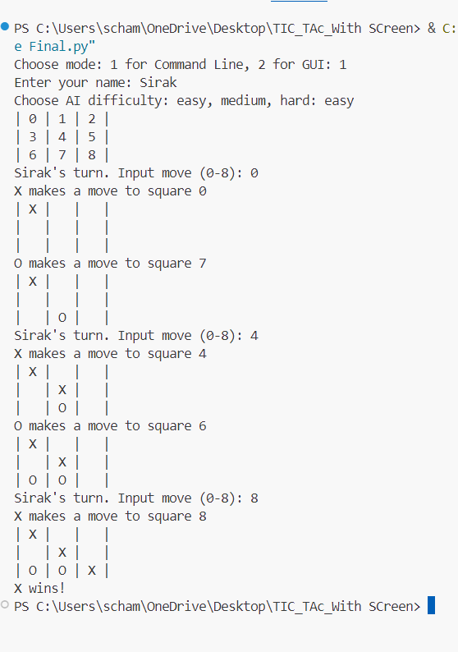
Screenshot:Human Wins

Slide 12

Conclusion
Content:
Summarized the implementation and key methods.
Highlighted the AI algorithms and principles used.
Explained the heuristic function and its importance in decision-making

Slide 13
Thank You
For Watching and Listening

Slide 14
References
1. Eppstein, D. (2004). Games, Puzzles, and Computation. 2. Russell, S., & Norvig, P. (2020). Artificial Intelligence: A Modern Approach (4th Edition). 3. Conway, J. H. (2001).On Numbers and Games. 4. Berlekamp, E. R., Conway, J. H., & Guy, R. K. (1982). Winning Ways for Your Mathematical Plays. 5 Smith, J. M. (1998). Evolution and the Theory of Games. 6 GeeksforGeeks: Tic-Tac-Toe Game Implementation 7 Khan Academy: Game Theory and Tic-Tac-Toe 8 Newell, A., & Simon, H. A. (1956). The Logic Theory Machine: A Complex Information Processing System. 9 Samuel, A. L. (1959). Some Studies in Machine Learning Using the Game of Checkers. 10 Ravi, V., & Meyer, B. (2009). Efficient Algorithms for Tic-Tac-Toe Variants.

